Slide 1
Research Question
Presentation by:
22099498
23092967
23069057
23105965

Slide 2
Dataset Id: 242
This dataset is important for us because it provides a rich source of data which can be analyzed in order to uncover patterns, trends, behavior and other market dynamics.
Notes:
The data set provides a rich source of data that can be analyzed to uncover trends, patterns, and insights into consumer behavior, market dynamics, and industry trends.

Slide 3
Dependent and independent variables:
In our dataset, the independent variables are many, such as buyer’s gender, age, discount and new car (true or false).
In our dataset, the dependent variable is only Sale Price.
Notes:
Independent variables is the variable that is manipulated or categorized to see its impact on other variables. In our dataset, the independent variables are many, such as buyer’s gender, age, discount and new car (true or false).
Dependent variables is is the outcome or response variable that is measured to see the impact of the independent variable.. In our dataset, the dependent variable is only Sale Price.

Slide 4
—Research Question
How does the age of buyers (Independent variable) and Discounts (Independent Variable) Influnce the sale price (dependent variable) of a car in the dataset?
Notes:
Now I would say that these variables help establish a causal relationship where the independent variables (Buyer Age, Discount) could explain variations in the dependent variable (Sale Price). The research questions based on the database are as follows: How does the age of buyers (Independent variable) and Discounts (Independent Variable) Influnce the sale price (dependent variable) of a car in the dataset?

Slide 5
Hypothesis
1. Null hypothesis (Ho):
Discounts and the Buyer’s age does not significantly impact Sale Price of Cars.
Notes:
The following null hypothesis assumes that there has been no relationship, difference or effect between the dependent and independent variable. It serves as the default position in order to test against whilst intending to reject it. in this dataset, discounts and buyer age do not significantly influence the Sale Price of cars. This reflects that any observed variation in Sale Price is due to random chance or other factors not considered in the study.

Slide 6
Hypothesis
2. Alternative Hypothesis (H₁)
Buyer Age and Discount significantly impact the Sale Price of cars.
Notes:
This hypothesis is the opposite to the null hypothesis which assumes the difference, effect and relationship between dependent and independent variable. If the null hypothesis is rejected and this one is then supported. In this case, Buyer Age and Discount significantly influence the Sale Price of cars which reflects the changes in sale price is related to the changes in discount and buyer age.

Slide 7

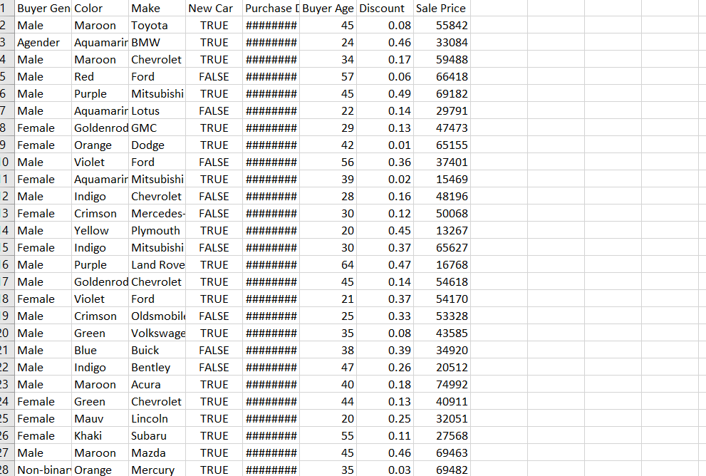
Dataset Overview
HOME

Slide 8
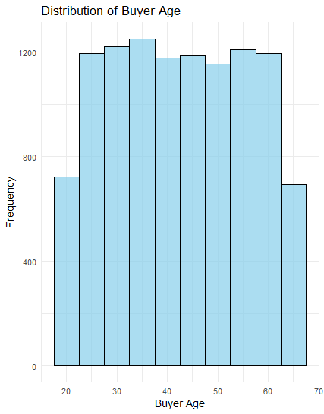
Histogram
The histogram of buyer age shows a roughly symmetric distribution centered around middle-aged individuals, with the highest frequency of buyers falling between the ages of 40 and 55. This distribution suggests that the primary market for car sales in this dataset consists of middle-aged individuals, likely due to greater financial stability and the likelihood of needing vehicles for commuting or family logistics. The lower frequencies for younger (below 30) and older ages (above 60) imply these age groups are less engaged in purchasing cars, possibly reflecting financial constraints among younger buyers and reduced needs or fixed incomes among older buyers. This insight can guide marketing strategies and product offerings to better cater to the most active buyer age groups, enhancing sales and customer targeting.
Notes:
This histogram provides us with a clear picture of our primary customer age groups. We observe that the most frequent buyers of cars are aged between 40 and 55, indicating a market segment with potentially higher financial stability and specific needs related to family or professional commuting. The lower frequencies among younger and older ages highlight areas where market penetration could be increased, or specialized marketing strategies could be developed

Slide 9
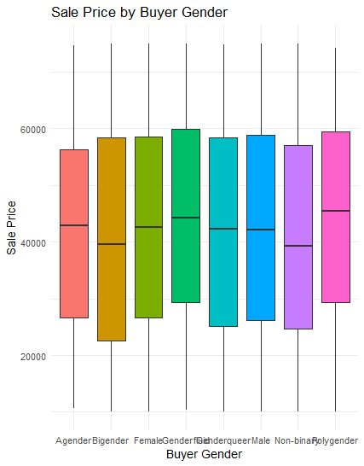
Box Plot
The boxplot illustrating sale prices by buyer gender reveals notable differences in median sale prices across various gender categories, with Male and Non-binary individuals showing higher median sale prices compared to other groups such as Agender, Bigender, Female, and Genderqueer. These variations suggest distinct purchasing patterns or financial capacities among the groups, with Male and Non-binary buyers potentially favoring more expensive vehicle options. This insight could inform targeted marketing strategies and product positioning by auto dealerships, aiming to customize their approaches to align with the financial tendencies and preferences observed within each gender category, thereby enhancing sales effectiveness and customer satisfaction.
Notes:
In this slide, we examine the distribution of car sale prices across various gender categories. Our boxplot reveals distinct purchasing patterns, with Male and Non-binary buyers showing higher median sale prices compared to other groups. This pattern suggests that different gender groups may have varying purchasing power or preferences, which could be utilized in marketing strategies to target specific demographics more effectively. The uniformity across the lower price ranges suggests a broad appeal of certain car models across all genders.

Slide 10
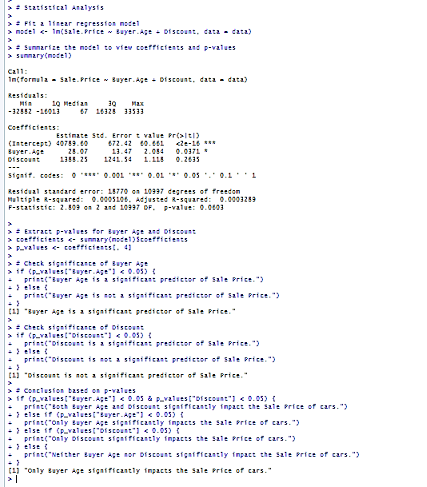
Statistical Analysis
The linear regression analysis indicates that Buyer Age is a statistically significant predictor of the Sale Price of cars, with a positive coefficient suggesting that as buyer age increases, so does the sale price, albeit the effect is small. The variable Discount, however, does not significantly impact the Sale Price, as its p-value exceeds the typical significance level, indicating that discounts might not be a deciding factor in car pricing strategies. The model’s overall explanatory power is very low (Adjusted R-squared = 0.0003289), suggesting that other variables not included in the model might be more influential in determining the sale price. This analysis highlights the importance of considering demographic factors such as age in pricing strategies while possibly reevaluating the effectiveness of discounts in influencing buyer decisions.
Notes:
Our regression analysis focuses on understanding the impact of buyer age and discounts on car sale prices. We find that buyer age is a significant predictor, suggesting a trend where older buyers tend to purchase more expensive cars. This might reflect greater financial resources or different priorities such as preference for higher-end models. On the other hand, discounts do not appear to significantly influence sale prices, which could imply that our pricing strategies are either already optimized or that other factors like car features or brand reputation play a more pivotal role in purchase decisions

Slide 11
Conclusion
Our analysis focused on understanding how Buyer Age and Discount impact the Sale Price of cars. The hypothesis tested whether these variables significantly affect car prices. Statistical findings from the linear regression model reveal that Buyer Age is a significant predictor, affirming that as buyers get older, they tend to purchase more expensive cars. This result supports our alternative hypothesis that Buyer Age significantly impacts Sale Price. Conversely, Discount was not found to significantly influence Sale Price, supporting the null hypothesis for this variable. The low R-squared value suggests that additional factors not included in this model might play more critical roles in determining car prices. These insights can guide further research to explore other potential influences on car pricing and refine marketing strategies to better target key demographics.
Notes:
Our analysis validated the hypothesis that buyer age significantly influences car sale prices, aligning with our predictions about market behaviors and preferences. The non-significant impact of discounts on sale prices leads us to reconsider their effectiveness as a sales tool. Given the low explanatory power of our model, future research should explore additional variables that could affect sale prices, such as car features, economic conditions, or more nuanced demographic factors. These insights will be crucial for refining our business strategies and aligning our products with consumer needs.

Slide 12

1. Null hypothesis (Ho):
Discounts and the Buyer’s age does not significantly impact Sale Price of Cars.
Notes:
The following null hypothesis assumes that there has been no relationship, difference or effect between the dependent and independent variable. It serves as the default position in order to test against whilst intending to reject it. in this dataset, discounts and buyer age do not significantly influence the Sale Price of cars. This reflects that any observed variation in Sale Price is due to random chance or other factors not considered in the study.

